Slide 1
Streaming
Notes:
Welcome to the Streaming and Integration Patterns module. This section will explore patterns that leverage continuous data streams and facilitate effective integration between systems. These patterns are crucial for building real-time applications and ensuring seamless communication across architectural components.
By the end of this module, you will know to design messaging solutions that can handle continuous data streams and integrate various systems effectively. Let’s now check out the techniques to elevate your messaging capabilities to support real-time and integrated applications!

Slide 2
Streaming
Pattern 1: Event Streaming

Slide 3
What is Event Streaming
Continuous flow of data recorded and processed in real time
Enables real-time data processing
Notes:
Definition
Event streaming is a messaging pattern where continuous flow of data (events) is recorded and processed in real-time. Events are captured from sources like databases, applications, or devices and delivered to various consumers for processing.
Purpose
It enables real-time data processing, allowing systems to react to events as they happen, rather than relying on batch processing.

Slide 4

Key Components & Flow
Event Stream
Producer
Consumer
Notes:
Event Producer
The source that generates and sends events (e.g. sensors, applications, databases)
Event Stream
The channel through which event flows, often managed by a streaming platform (e.g. Apache Kafka, Azure Event Hubs).
Event Consumer
The component or service that reads and processes events from the steam.

Slide 5
Key Components & Flow
Event Stream
Producer
Consumer
Notes:
Event Producer
The source that generates and sends events (e.g. sensors, applications, databases)
Event Stream
The channel through which event flows, often managed by a streaming platform (e.g. Apache Kafka, Azure Event Hubs).
Event Consumer
The component or service that reads and processes events from the steam.

Slide 6
Benefits
Low Latency
Scalability
Flexibility
Notes:
Low Latency: Immediate processing of data as events occur.
Scalability: Efficiently handles large volumes of data.
Flexibility: Supports various consumers and processing requirements.

Slide 7
Drawbacks
Complexity
Infrastructure Setup
Data Processing
Skills Requirements
Notes:
Complexity in Implementation and Maintenance
Infrastructure Setup: Setting up and managing the infrastructure for event streaming, such as Apache Kafka or Azure Event Hubs, can be complex. It requires careful planning, configuration, and ongoing maintenance.
Data Processing: Designing and implementing real-time data processing pipelines can be challenging, especially when dealing with high volumes of data and ensuring low-latency processing.
Skills Requirements: Requires specialized skills and knowledge to implement and maintain effectively, which may be a barrier for some teams.

Slide 8
Drawbacks
Complexity
Latency
Resource Intensive
Scalability Challenges
Latency Management
Notes:
Scalability and Resource Management
Resource Intensive: Event streaming systems can be resource-intensive, requiring significant computational and storage resources to handle high volumes of data and ensure real-time processing.
Scalability Challenges: While event steaming systems are designed to scale, ensuring efficient and cost-effective scaling can be challenging. Balancing the load across multiple consumers and managing resource allocation effectively is crucial.
Latency Management: As the system scales, managing and minimizing latency to ensure timely processing of events becomes increasingly complex.

Slide 9
Drawbacks
Complexity
Latency
False Positives
Data Loss Risk
Event Ordering
Error Handling
Notes:
Data Consistency and Reliability
Data Loss Risk: Ensuring data consistency and reliability in a distributed event streaming stem can be challenging. There is always a risk of data loss or duplication, especially during network failures or system crashes.
Event Ordering: Maintaining the order of events Is critical for certain applications. Ensuring that events are processed in the correct sequence across multiple consumers can be difficult.
Error Handling: Implementing robust error handling and recovery mechanisms to deal with failed or delayed events requires careful consideration and design.

Slide 10
Use Cases
Real-Time Analytics
Data Integration
IoT Applications
Notes:
Real-Time Analytics
Processing streaming data for immediate insights, such as stock market analysis or user activity monitoring.
Data Integration
Synchronizing data across multiple systems in real-time.
IoT Applications
Handling data from Internet of Things (IoT) devices for immediate action or analysis.

Slide 11
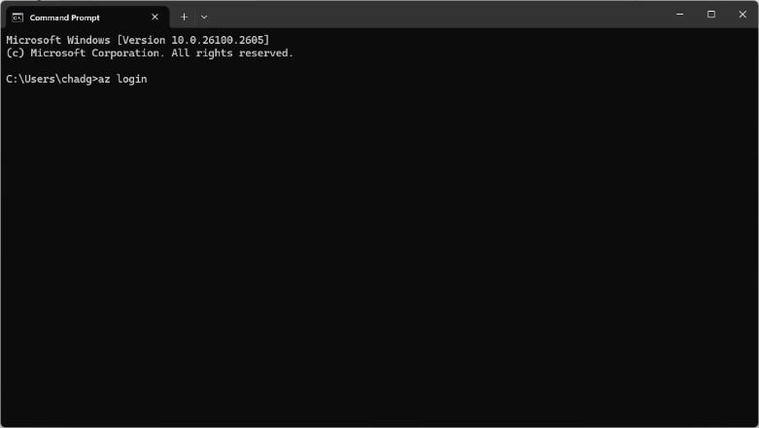
Demonstration
Create the Namespace

Slide 12
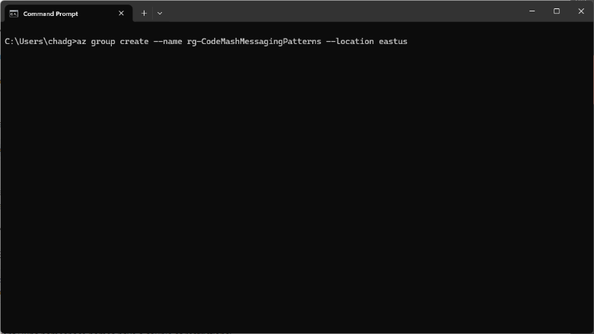
Demonstration
Create the Namespace
Notes:
Log into Azure
az login

Slide 13
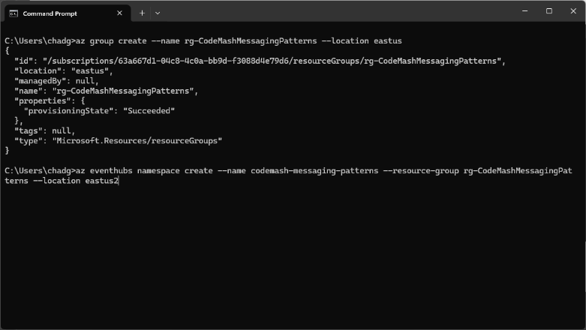
Demonstration
Create the Namespace
Notes:
Create the Namespace
az eventhubs namespace create --name codemash-messaging-patterns --resource-group rg-CodeMashMessagingPatterns --location eastus2

Slide 14
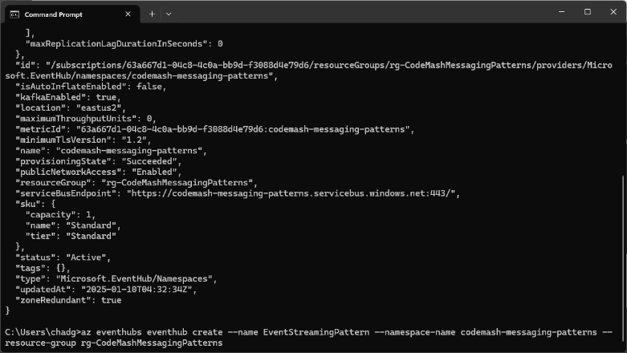
Demonstration
Create the Namespace
Create an Event Hub
Notes:
Create the Event Hub
az eventhubs eventhub create --name EventStreamingPattern --namespace-name codemash-messaging-patterns --resource-group rg-CodeMashMessagingPatterns

Slide 15
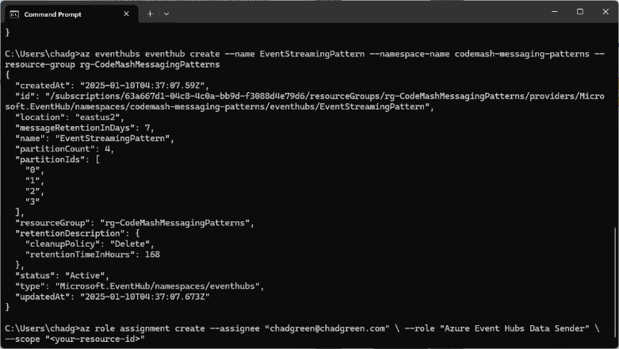
Demonstration
Create the Namespace
Create an Event Hub
Assign Roles
Notes:
Assign Azure Event Hubs Data Sender
az role assignment create --assignee “chadgreen@chadgreen.com" --role "Azure Event Hubs Data Sender" --scope "<your-resource-id>"
Assign Azure Event Hubs Data Receiver
az role assignment create --assignee “chadgreen@chadgreen.com" --role "Azure Event Hubs Data Receiver" --scope "<your-resource-id>"

Slide 16
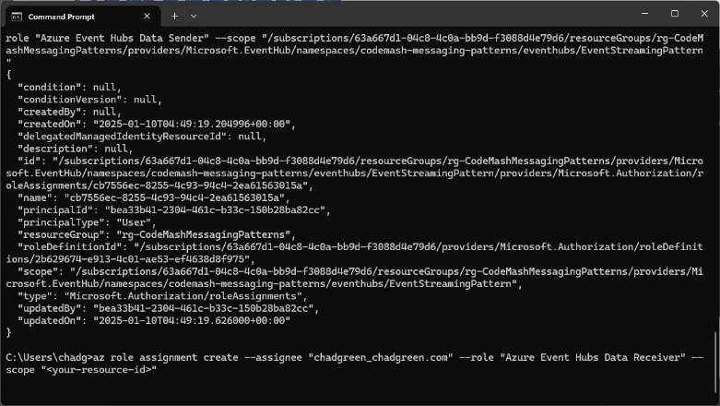
Demonstration
Create the Namespace
Create an Event Hub
Assign Roles
Notes:
Assign Azure Event Hubs Data Sender
az role assignment create --assignee “chadgreen@chadgreen.com" --role "Azure Event Hubs Data Sender" --scope "<your-resource-id>"
Assign Azure Event Hubs Data Receiver
az role assignment create --assignee “chadgreen@chadgreen.com" --role "Azure Event Hubs Data Receiver" --scope "<your-resource-id>"

Slide 17
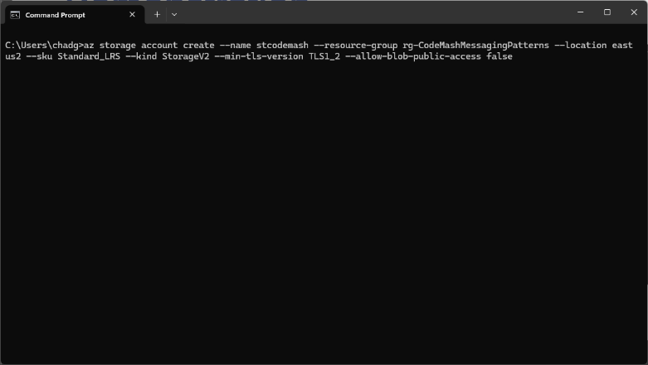
Demonstration
Create the Namespace
Create an Event Hub
Assign Roles
Create Storage Account
Notes:
Create Storage Account
az storage account create --name stcodemash --resource-group rg-CodeMashMessagingPatterns --location eastus2 --sku Standard_LRS --kind StorageV2 --min-tls-version TLS1_2 --allow-blob-public-access false

Slide 18
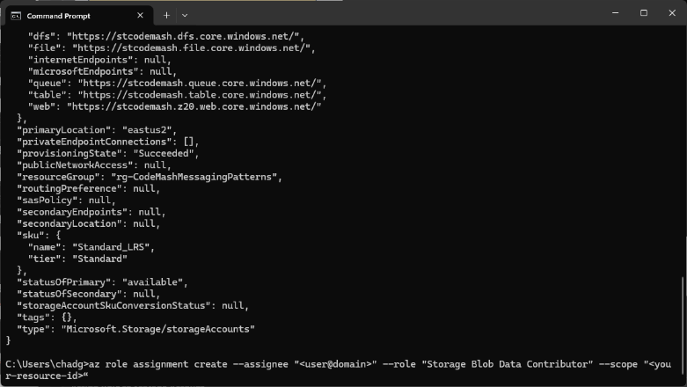
Demonstration
Create the Namespace
Create an Event Hub
Assign Roles
Create Storage Account
Notes:
Assign Role to Storage Account
az role assignment create --assignee "<user@domain>" --role "Storage Blob Data Contributor" --scope "<your-resource-id>“

Slide 19
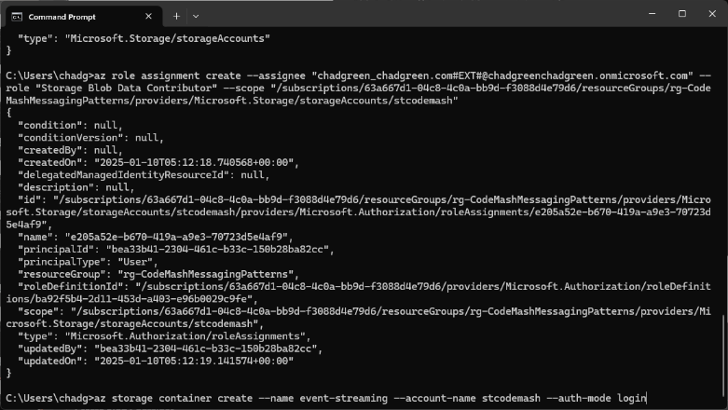
Demonstration
Create the Namespace
Create an Event Hub
Assign Roles
Create Storage Account
Notes:
Create Blob Container
az storage container create --name event-streaming --account-name stcodemash --auth-mode login

Slide 20
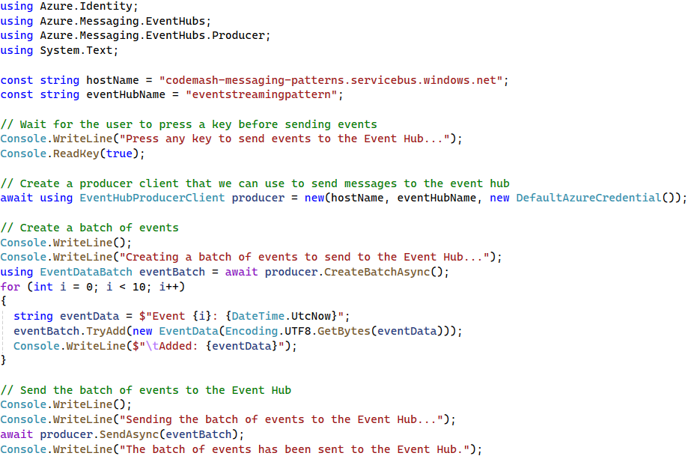
Demonstration
Create the Namespace
Create an Event Hub
Assign Roles
Create Storage Account
Create a Message Producer
Notes:
Create a Message Producer
Use the Azure SDK to send a message to the codemash.fundamentals.point-to-point queue.

Slide 21
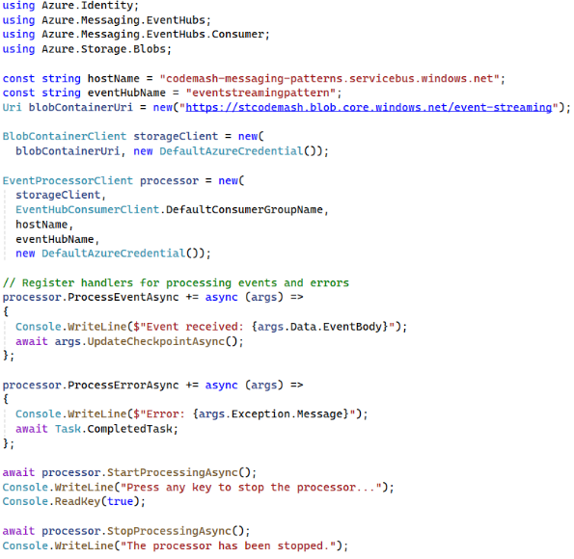
Demonstration
Create the Namespace
Create an Event Hub
Assign Roles
Create Storage Account
Create a Message Producer
Notes:
Create a Message Producer
Use the Azure SDK to send a message to the codemash.fundamentals.point-to-point queue.

Slide 22
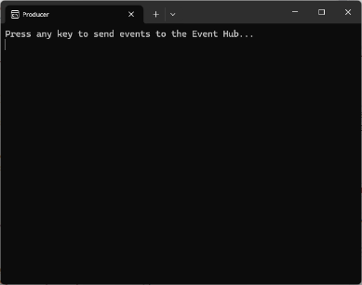
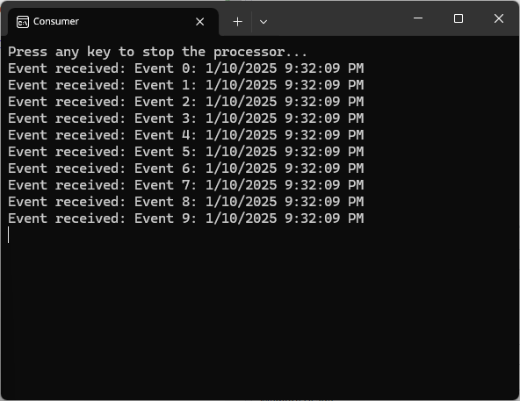
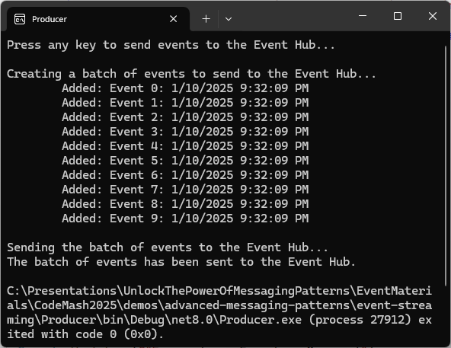
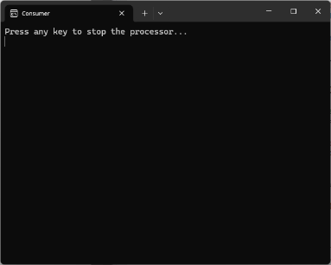
Demonstration
Create the Namespace
Create an Event Hub
Assign Roles
Create Storage Account
Create a Message Producer
Create a Message Producer
Notes:
Run the Demo
Execute the producer code to send a message.
Execute the consumer code to receive and process the message.
Observer the message flow from the producer to the consumer.

Slide 23
Key Points to Remember
Real-time processing on data enables quick decision-making and responsiveness.
Event streaming supports high volumes of data and multiple consumes.
Enhances data integration and real-time analytics capabilities.

Slide 24
Streaming
Wrap-Up
Notes:
As we conclude the Streaming and Integration Patterns module, let’s summarize the key patterns and insights we have covered, and preview what is coming up next.

Slide 25
Key Takeaways
Event Streaming
Notes:
Key Takeaways:
Event Streaming: Understanding the principles of continuous data streams and their importance in real-time applications.
These patterns have equipped you with advanced techniques to handle real-time data processing and system integration, ensuring your messaging solutions are robust and efficient.

Slide 26
Preview of What’s Next in the Workshop
Messaging Essentials
Core Messaging Patterns
Routing & Processing
Advanced Processing Techniques
Resilience & Reliability
Streaming & Integrations
Design Considerations
Hands-On Exercises

Slide 27
Preview: Design Considerations
Design Considerations
Reliability
Scalability
Performance
Security
Fault Tolerance
Flexibility & Adaptability
Notes:
In the next module, we will explore crucial design considerations that impact the overall architecture and performance of your messaging solutions. Here is a glimpse of what is to come:
Reliability: Ensuring consistent and dependable message processing.
Scalability: Designing systems that can handle increased load effectively.
Performance: Optimizing message processing for speed and efficiency.
Security: Implementing measures to protect your messaging systems.
Fault Tolerance: Building systems that can recover gracefully from failures.
Flexibility and Adaptability: Designing solutions that can evolve with changing requirements.
This module will provide you with essential insights into designing messaging systems that are not only functional but also robust, scalable, and secure. Stayed tuned as we go into these critical aspects of designing resilient and adaptable messaging solutions!

